Slide 1



AGRIBUSINESS
April 2024

Slide 2

Table Of Content
Content List
01.
03.
Agribusiness
Business Plan
02.
04.
Entrepreneurship
Sources

Slide 3

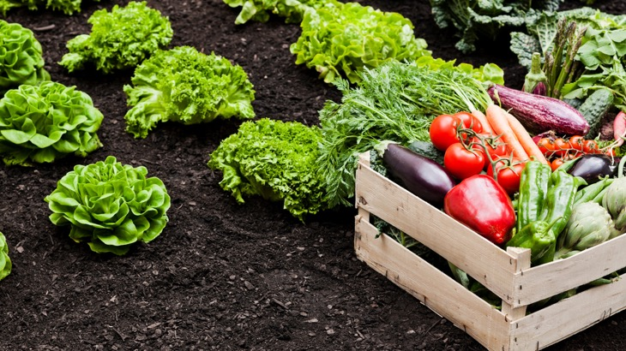
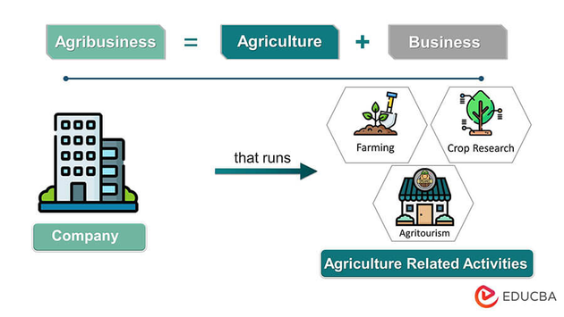
Agribusiness
Definition
the group of industries dealing with agricultural produce and services required in farming. (Source: Oxford dictionary).
Introduction

Slide 4
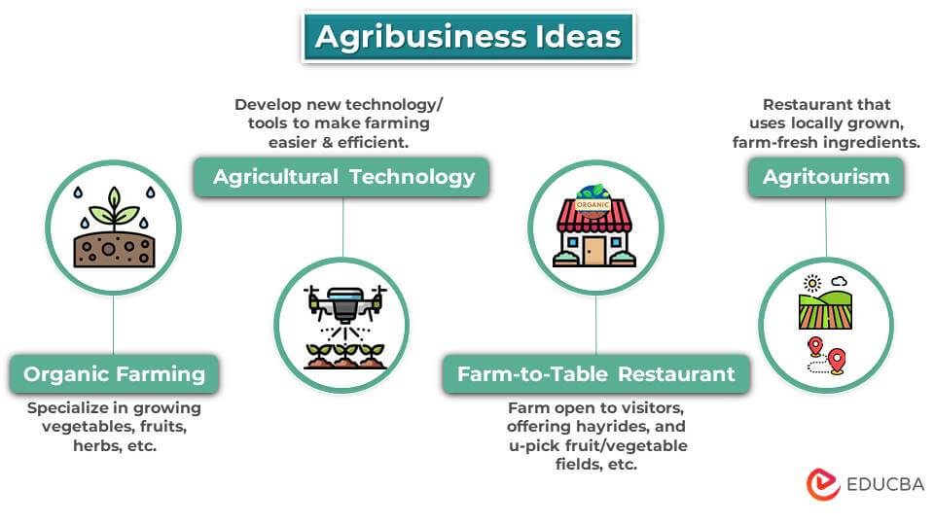

Slide 5

Entrepreneurship
Definition
the activity of setting up a business or businesses, taking on financial risks in the hope of profit. (Source: Oxford dictionary).
Introduction

Slide 6
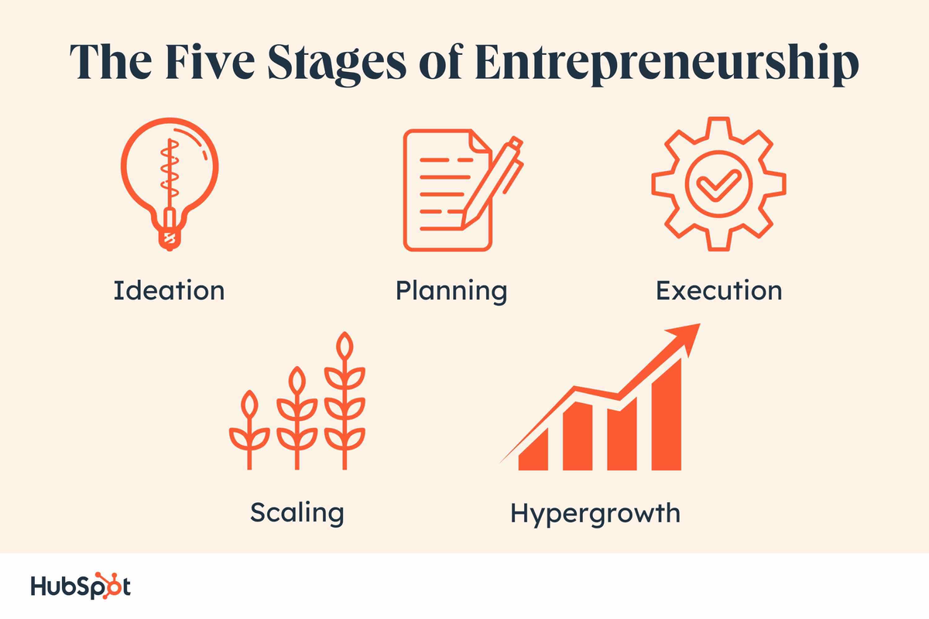

Slide 7
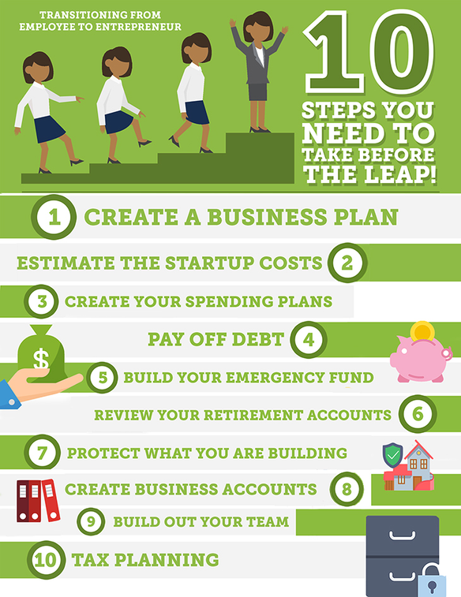
Source: https://www.cnbc.com/2018/11/12/10-steps-to-take-before-making-that-final-entrepreneurship-leap.html
Source: Rianka Dorsainvil/Your Greatest Contribution

Slide 8

Business Plan
Definition
a document setting out a business's future objectives and strategies for achieving them.(Source: Oxford dictionary).
Introduction

Slide 9
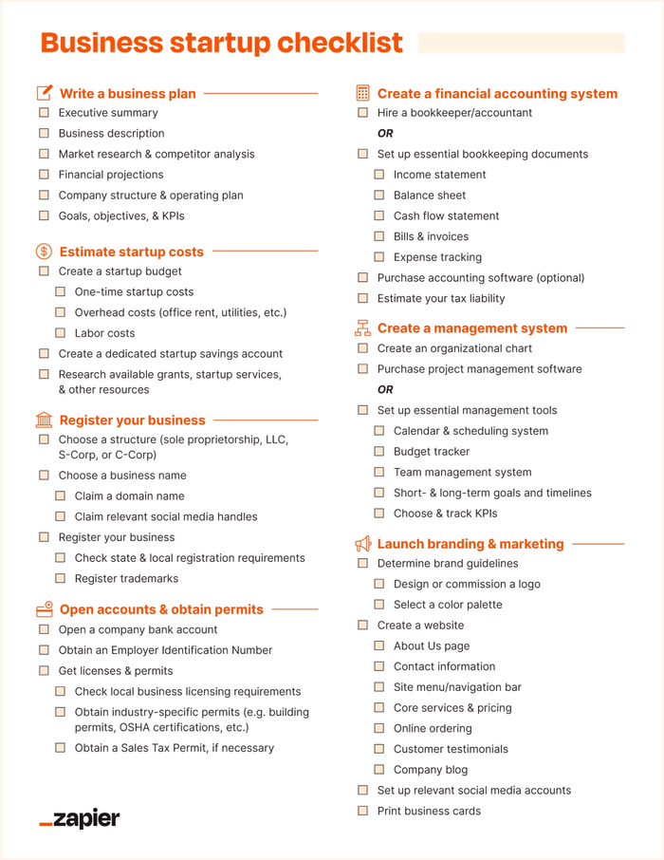
Source: https://zapier.com/blog/business-startup-checklist/

Slide 10
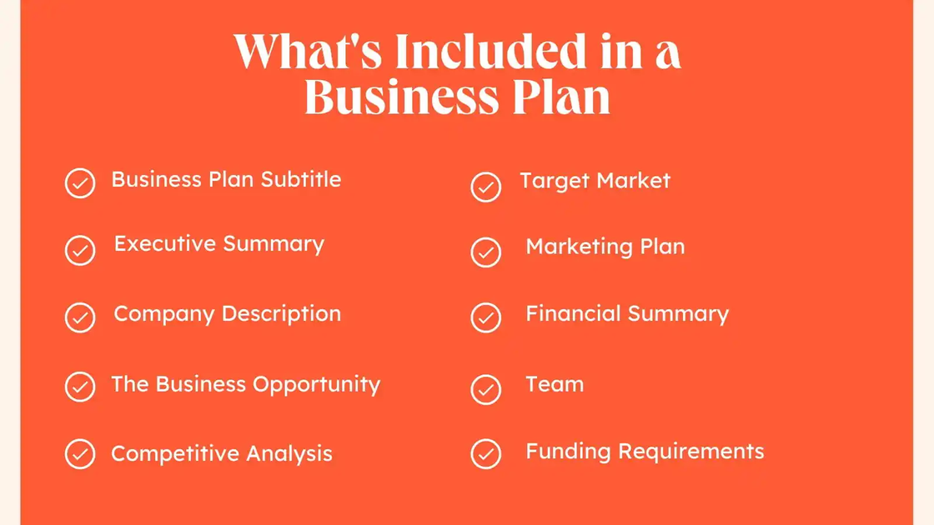
Source: https://blog.hubspot.com/marketing/what-is-business-plan

Slide 11


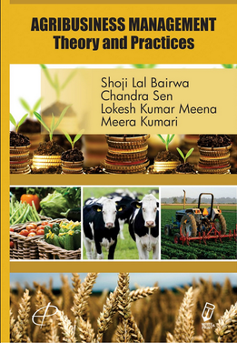

Sources

Slide 12
AGRIBUSINESS
April 2024

